Slide 1
BMA Electives
2023-2024

Slide 2
Grades and Amount of Electives Allowed
Sophomores will have 1-2 electives
Juniors will have 3 electives
Seniors will have 4 electives
When you fill out the course selection form you will choose more than the electives you will have to give you some options in case classes get full.

Slide 3
Journalism (1 credit)
Journalism is a one-semester, ​1 credit course offered as an English elective. The course is designed for students of all grades who want to learn basic newspaper skills to enhance their knowledge of writing, the craft of journalism, and the career opportunities associated with this field of study. Students will learn and create news writing, in-depth reporting, editorials, features, sports writing, entertainment, pictures, headline preparation, design and layout are some of the areas covered. Additional areas of focus include the history and social significance of print journalism and the media, ethics in journalism, freedom of the press, and student press law. The course seeks to deepen student understanding of the art of journalism and prepare students who are interested in any of the following areas: writing for the school newspaper, careers in journalism, photo-journalism, advertising, sales, and marketing.
This Photo by Unknown author is licensed under CC BY.

Slide 4
Creative Writing (1 credit)
Creative Writing is a course that provides students with the opportunity to creatively express themselves through writing, visuals, poetry, music, speaking, collaboration, etc. Students will engage in a variety of formal and informal creative writing tasks that will develop their authentic voice. Students will display their creative samples in a course developed Literary Magazine that will be edited and revised by all members of the class and then published and shared with the school.

Slide 5
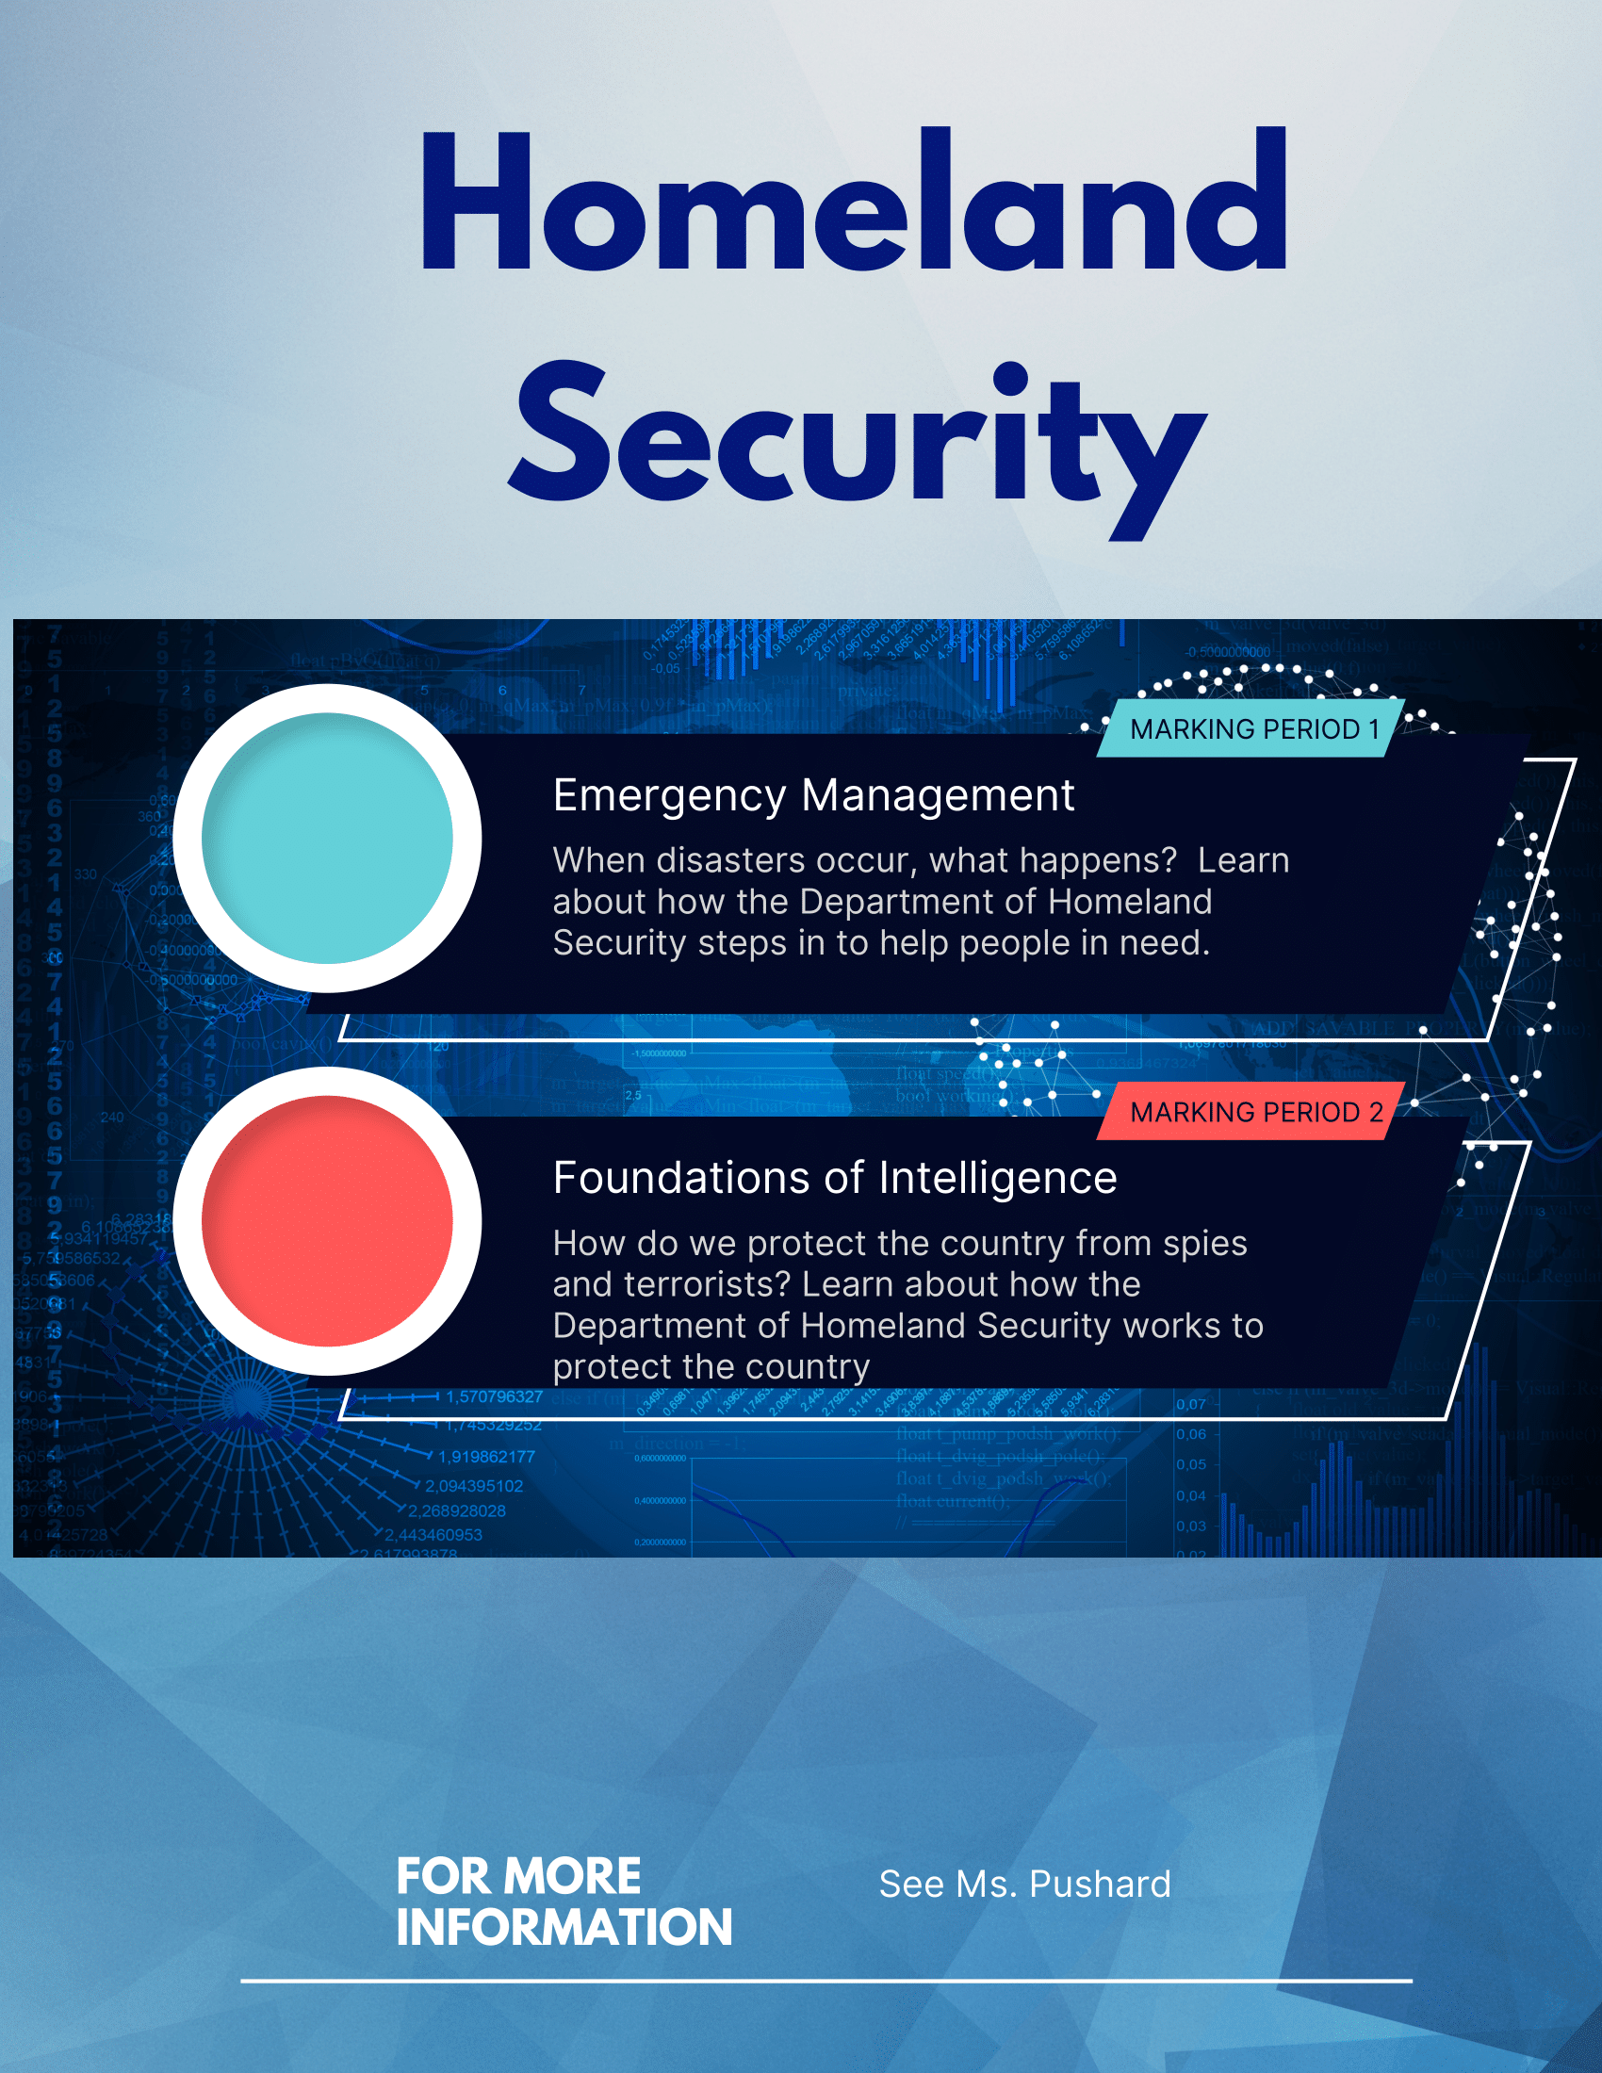
Homeland Security (1 credit)
Homeland Security is a course that focuses on managing emergencies and national security. In Emergency Management, students will explore the impact of natural and man-made disasters like hurricanes and nuclear energy meltdowns and have the opportunity to experience what it is like to manage a disastrous event. In Foundations of Intelligence, student will learn about the United States' history with secret agents, terrorist attacks, and how it all applies to the world today.

Slide 6
Disaster History (1 credit)
Disaster History is an in depth study of the disasters that have changed the world in which we live. Students spend one marking period studying the structural and wildfires that changed fire code and firefighting and one marking period studying epidemics (diseases) that have had a major impact on society. The course ends with an all-day zombie pandemic drill that puts students in charge of managing a zombie outbreak! Disaster History must be taken with Disaster Science.

Slide 7
Psychology for Law Enforcement (1 credit)
Psychology for Law Enforcement is an opportunity to study the human mind and behaviors as they apply to crime and punishment. Discover how profiles of serial killers are made, why our memories of crimes can't be trusted, why people confess to crimes they didn't commit and how mental illness affects society. Students learn through experiential activities, games, seminars, and interactive activities. Students can apply learning in this class both in and out of the classroom.

Slide 8
EMS Science (1 credit)
This class is not like any other. While this class will not lead to an EMT certification, you will get a fast paced, realistic introduction of what it takes to be a first responder. You will study anatomy and physiology, lifting and moving, PTSD, as well as, any and all medical and trauma scenarios as it pertains to EMS. You will also become certified through Operation Underground Railroad (O.U.R.) in how to spot human trafficking. Some of the content may be difficult at times, but class is a precursor to the EMT class leading to certification.

Slide 9
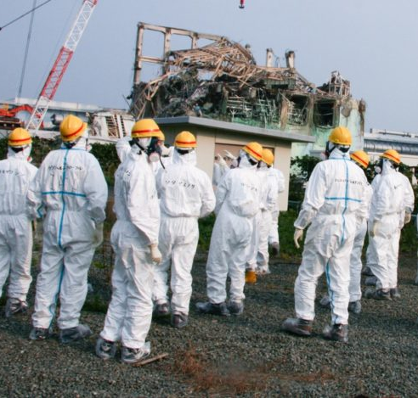
Disaster Science (1 credit)
This course is designed for students seeking a career in understanding the scientific aspects of a fire and the evolution of epidemics and infectious diseases. The fire component of the course will use four major fire disasters to explain and identify basic fire chemistry and physics. This course will also identify different characteristics of fire materials, exploring fire protection systems, basic fire-control procedures and flammable liquids. The epidemics and infectious disease portion will focus on exploring major epidemics that have affected the world and how these epidemics changed the understanding of how scientists understand modern epidemiology. This course is designed to be taken with Disaster History. . Prerequisites: Passed physical science and biology with a “C” or higher to enroll.
This Photo by Unknown author is licensed under CC BY-NC.

Slide 10
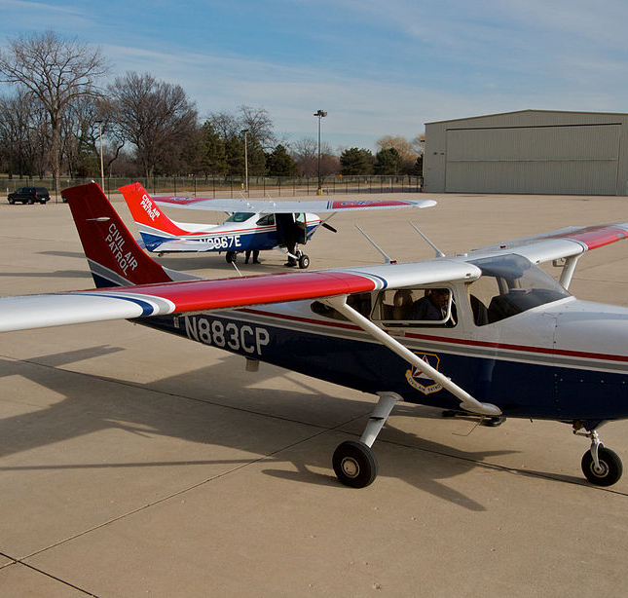
Civil Air Patrol 1 or 2 (1 credit)
CAP - By paying only $45.00 in annual dues and taking this class, you are provided the opportunity to pilot a Cessna 172 single-engine airplane five times for an hour each flight; fly in a Black Hawk helicopter around CT, fly in a C-130 Hercules Cargo Airplane around CT, attend the weeklong summer encampment from July 28-August 5, 2023, for free (normally $250) at Camp Nett in Niantic, CT; purchase a dress blues uniform at half-price ($100), purchase an Airman Basic Uniform (ABU - digitized camouflage) at half-price ($100), go on free field trips around the country, learn to fly gliders (for free), and fulfill the three missions of CAP: Emergency Services (ES - Search and Rescue, Disaster Relief, etc.), Cadet Services (CP - Drill and Ceremonies, Color Guard, Honor Guard, etc.), and Aerospace Education (AE - flying, model rockets, cybersecurity, airspace, ). Along the way, we will endeavor to mold you into a strong leader and provide you with community service opportunities to help you make the world a better place.
This Photo by Unknown author is licensed under CC BY-SA.

Slide 11
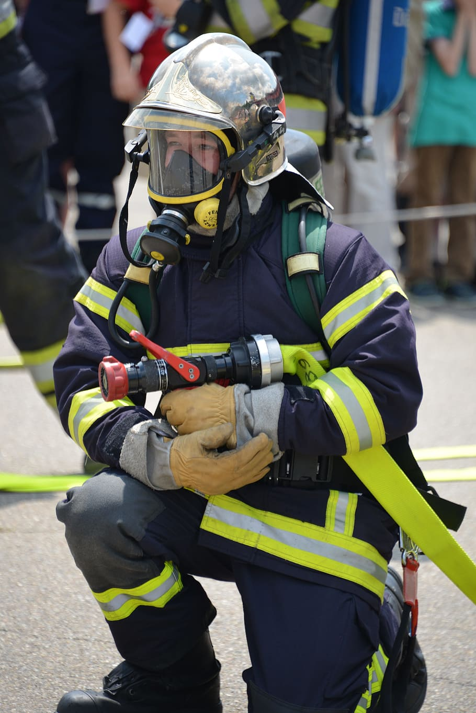
Fire Science (1 credit)
This course provides students with an overview of skills necessary for entry-level employment in a fire science career. Students will learn basic firefighter theory and skills. Topics covered will include: fire science, leadership, organization, rules and regulations, firefighter safety, characteristics and behavior of fires, and fire prevention and control. Students will also learn fire equipment use, safety, maintenance, hazardous materials response techniques, incident command principles, and search and rescue techniques. This course will expose students to skills that they will be taught in a fire academy. Much of the course includes outdoors hands-on practical work.

Slide 12
EMT Class (2 credits)
This prehospital training course provides lectures and skills practice required for entry-level practitioners to train for the management of medical and trauma patients at the basic life support level.

